Slide 1
(AzSK) Azure Security Toolkit (et al.) & Top Reasons You’re a Data Breach Candidate
Hugo shebbeare
Winooski, VT, Feb 11, 2019 For SQLPASS Vermont (Roman Rehak, pres.)

Slide 2
Steps to AzSK (Azure Security Toolkit) modules, install, import, Evaluate
Install
Open PowerShell as Administrator
Install Module
Import Module
Set-ExecutionPolicy -Scope Process -ExecutionPolicy ByPS
Evaluation
Grab Subscription ID
Submit Get Services Security Status
import-module azsk –Force -Importing AzureRM modules. This may take a while...
Report locally staved

Slide 3
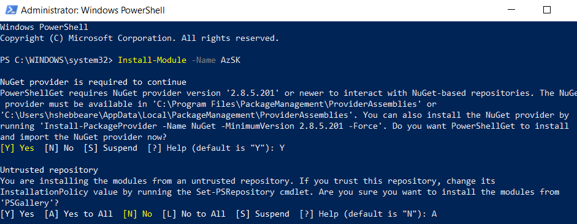
Install-Module –Name AzSK
Be sure to SPECIFY “Y” TO ALLOW nUGET repositories

Slide 4
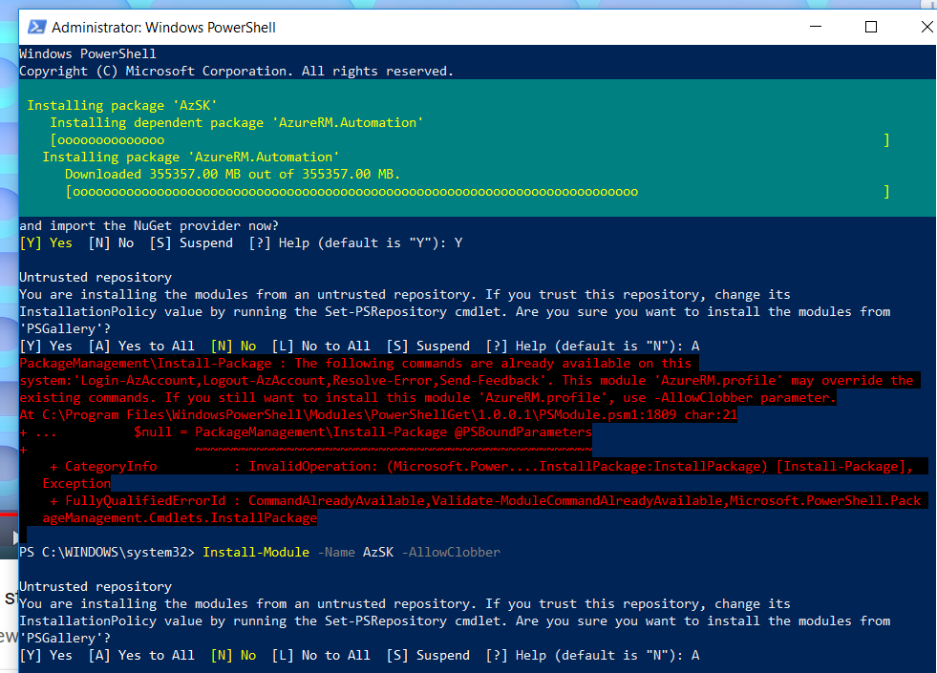
-AllowClobber parameter was required in my case… Progress is shown at the top during install (AzureRM..size is not 350gb btw, some calculation wrong there)

Slide 5
PS C:\WINDOWS\system32> Get-AzSKAzureServicesSecurityStatus -SubscriptionId YOURSubID (and then report provided in path below) AzSK: EULA and Privacy Disclosure: Please review the following: EULA (http://aka.ms/azskeula) Privacy Disclosure (http://aka.ms/azskpd) Enter 'Y' if you agree and 'N' if you don't (Y/N): Y Your response has been recorded. ================================================================================ azsk Version: 3.10.0 ================================================================================ Method Name: Get-AzSKAzureServicesSecurityStatus (GRS) Input Parameters: Name Alias Value ---- ----- ----- SubscriptionId s … You can also use: grs -s … ================================================================================ Running AzSK cmdlet using a generic (org-neutral) policy... Number of resources: 1 Number of resources for which security controls will be evaluated: 1 ================================================================================ Starting analysis: [FeatureName: SQLDatabase] [ResourceGroupName: RSG1] [ResourceName: intellabase] -------------------------------------------------------------------------------- Checking: [SQLDatabase]-[Enable Azure AD admin for the SQL Database] Checking: [SQLDatabase]-[Transparent data encryption (TDE) must be enabled] Checking: [SQLDatabase]-[Enable SQL Server threat detection with email admins option. Do not exclude any detection types] Checking: [SQLDatabase]-[Configure only the required IP addresses on SQL firewall. Do not use Any-to-Any IP range 0.0.0.0-255.255.255. 255] Checking: [SQLDatabase]-[Enable SQL Server audit with selected event types and retention period of minimum 365 days] Checking: [SQLDatabase]-[Review the Data Masking policy for SQL Database sensitive data columns if in use.] Checking: [SQLDatabase]-[Use the 'Allow access to Azure services' flag only if required.] -------------------------------------------------------------------------------- Completed analysis: [FeatureName: SQLDatabase] [ResourceGroupName: RSG1] [ResourceName: intellabase] ================================================================================ Summary Total Passed Failed Verify Manual ------- ----- ------ ------ ------ ------ High 6 1 2 1 2 Medium 6 0 1 1 4 ------ ------ ------ ------ ------ ------ Total 12 1 3 2 6 ------ ------ ------ ------ ------ ------ ================================================================================ ** Next steps ** Look at the individual control evaluation status in the CSV file. a) If the control has passed, no action is necessary. b) If the control has failed, look at the control evaluation detail in the LOG file to understand why. c) If the control status says 'Verify', it means that human judgement is required to determine the final control status. Look at the control evaluation output in the LOG file to make a determination. d) If the control status says 'Manual', it means that AzSK (currently) does not cover the control via automation OR AzSK is no t able to fetch the data. You need to manually implement/verify it. Note: The 'Recommendation' column in the CSV file provides basic (generic) guidance that can help you fix a failed control. You can al so use standard Azure product documentation. You should carefully consider the implications of making the required change in the conte xt of your application. Control results may not reflect attestation if you do not have permissions to read attestation data from AzSKRG -------------------------------------------------------------------------------- Detail logs exported to path - C:\Users\ME\AppData\Local\Microsoft\AzSKLogs\Sub_Free Trial\20190211_115014_GRS\ ================================================================================

Slide 6
General (not DBSEc) SDUTOOLS & DBATOOLS
very useful set of commands, and free
How to get DBATools on local workstation:
PS C:\WINDOWS\system32> Set-PSRepository -Name PSGallery -InstallationPolicy Trusted
PS C:\WINDOWS\system32> Install-Module dbatools SDUTools are a great set of stored procedures and functions, available for download, thanks to Greg Low (SQL Down Under)

Slide 7

Sad Observation: 80% of companies, from experience, treat the security of data as if they were flying a small plane, and neither would accept mountain peaks exist (thus not ready for a breach at all), nor treat data as an asset ( as if pax. are expendable).

Slide 8
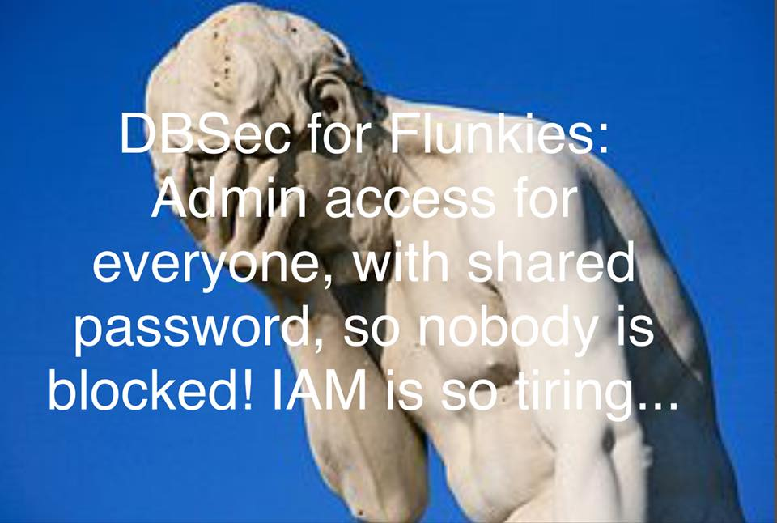
Who are Candidates for a Data Breach? Database Security Flunkies are those who leave out IAM (Identity and Access Management) If u r stuck working where this is the norm., remediate it, or if management wishes to ignore the issue: it’s probably not a company you want to stay working for (ethics, compliance, standards, …).

Slide 9
Other Top Reasons you’re a Candidate for a Data Breach:
SILOS: You’re trying to adjust to compliance, and an Exec tells you: ‘That’s not my department’ (ignorant of compliance, risk, security…)
Everyone has been granted SysAdmin server role in production… (groom them off)
Said by non-certified Project Manager who yells at the DBA while taking 20 minutes to patch an instance – ‘That’s disruptive!’ (patching covers CVEs, which are known exploits, shall we go into prod with them? Really?)
Have a security policy, but do nothing to evaluate, or prove that risk is managed (lacking vulnerability assessments, or penetration tests…)

Slide 10
Other Top Reasons you’re a Candidate for a Data Breach:
Want to implement basic database security best practices, and told you’re blocking someone
Solution: Situation indicates that the ‘shift left’ of security in DevOops or SDLC is non-existent, and that security is an afterthought, thus ensure inclusion from start
All the _ISMs: nepot, national, race, sex, linguic\ism), the usual nastiness to varying degrees used to marginalize the DBA trying to resolve security gaps/issues while executing daily duties
Solution: an HR department that is actually Human, and enforces a healthy work environment
Your CEO stands up and tells everyone to follow standards, and propagandizes how good their approach to Security is loudly outside the organization, yet internally wants FlunksAdmin user shared across the entire development team
Solution: principle of least privilege

Slide 11
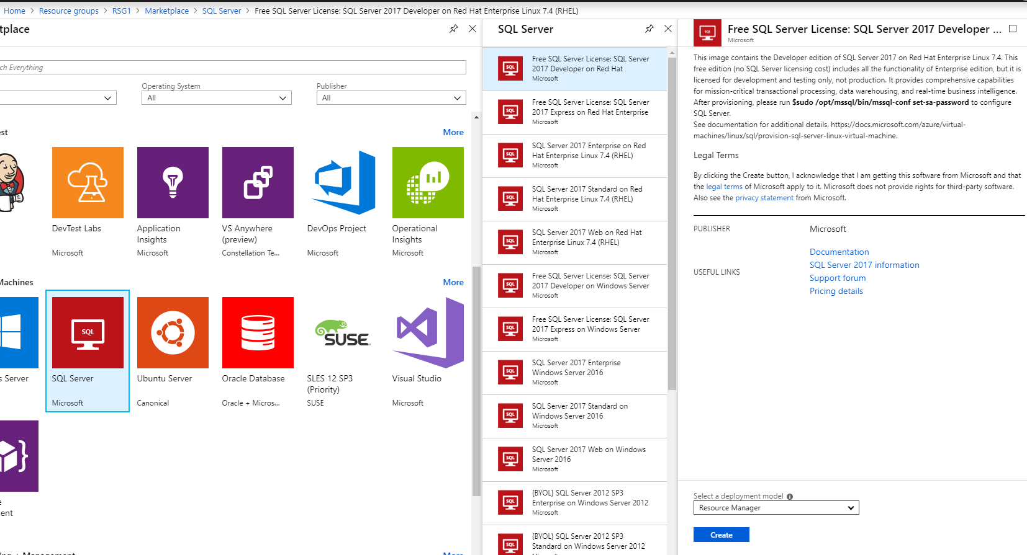
Don’t be a data breach candidate on Linux either !
Initializing Security for Linux installs (Red Hat example, path to install in Azure below) $sudo /opt/mssql/bin/mssql-conf set-sa-password

Slide 12
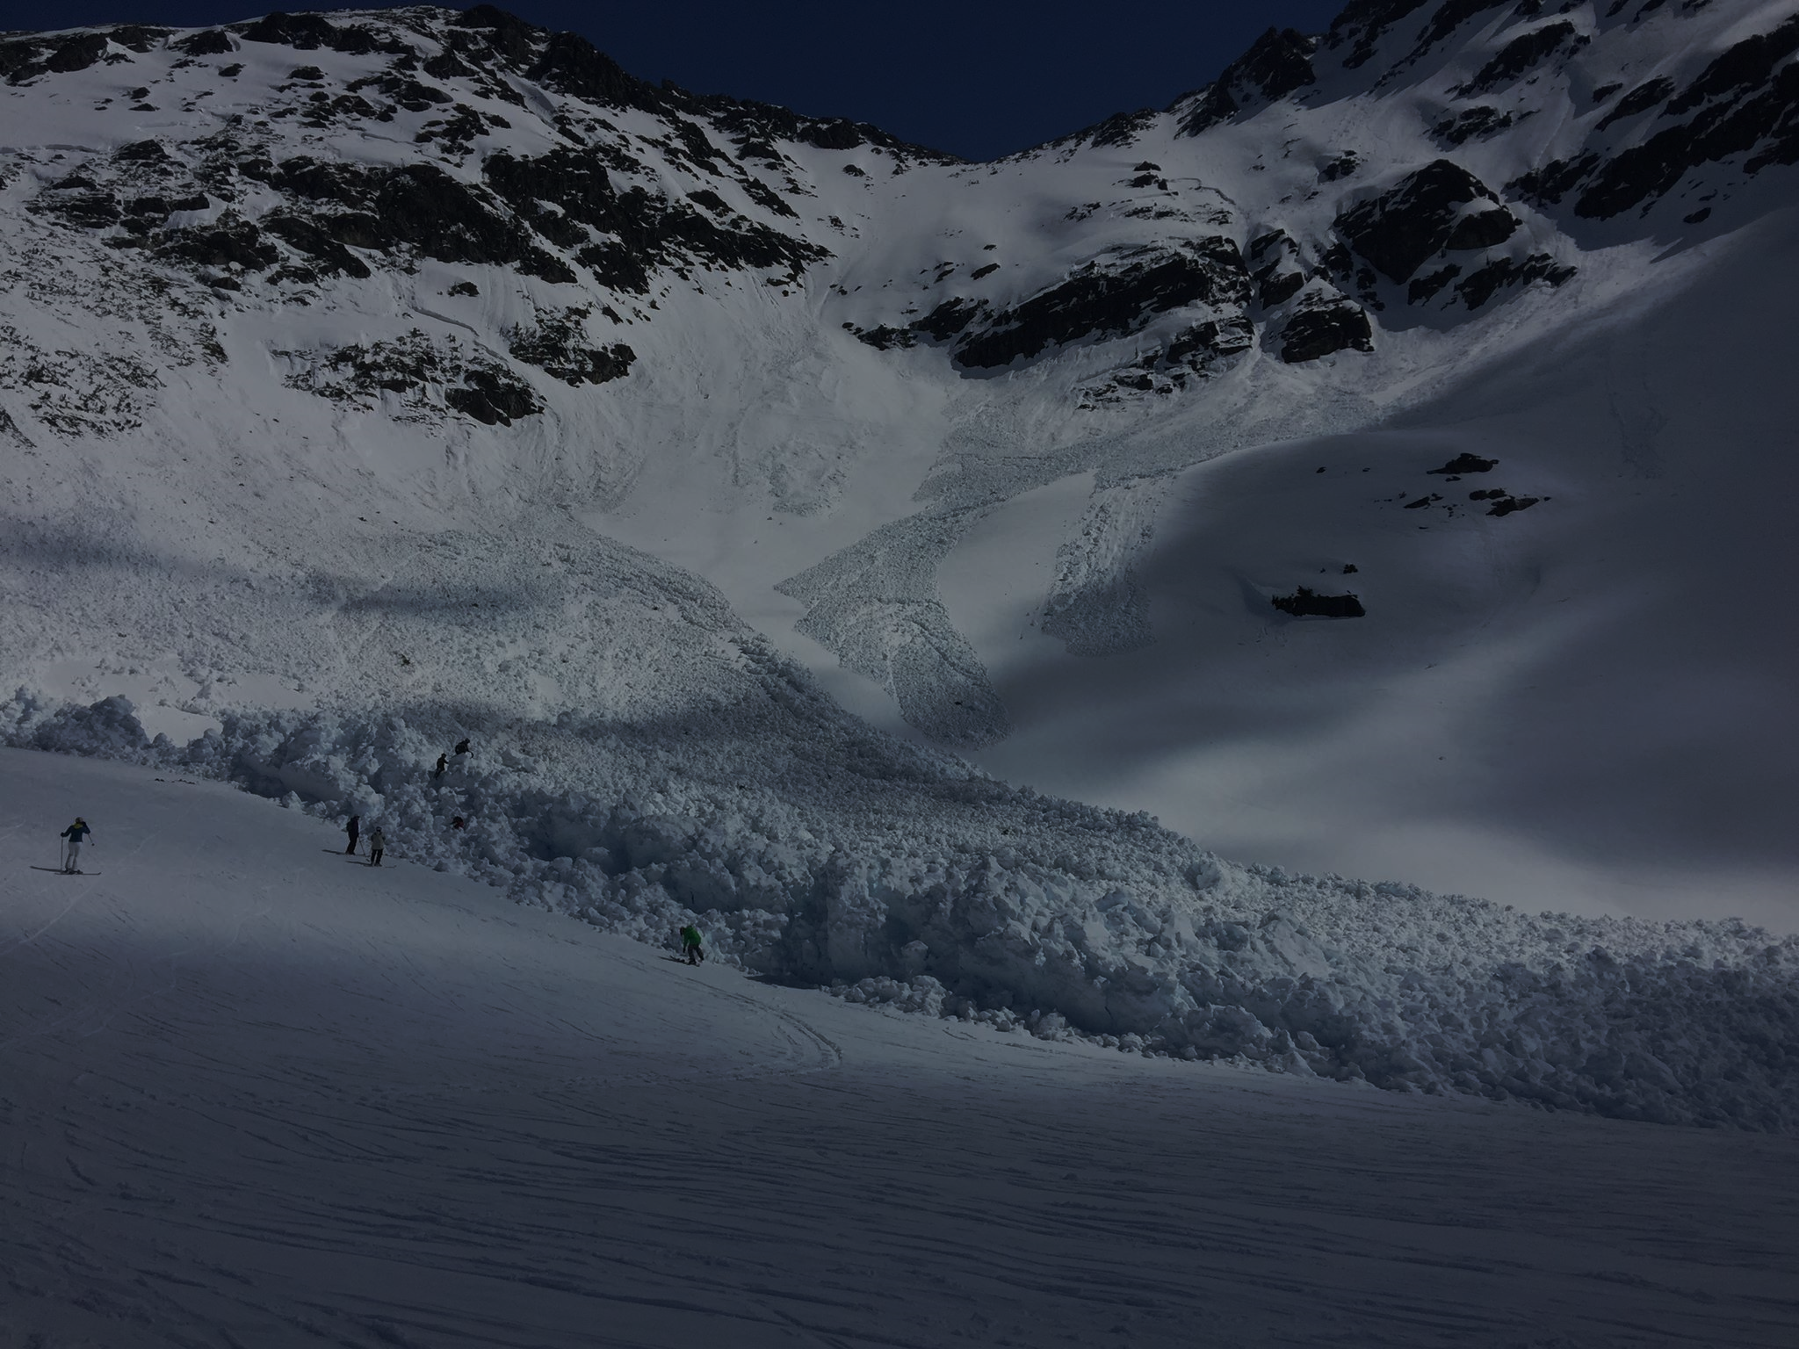
Review of Azure Security Center-
Do Not Forget to use these (no cost):
Vulnerability Assessments
Transparent Data Encryption
Data Masking
Develop Roles across your database systems, and one for each level (STG, Prod, Dev, TST, UAT, etc)
PWDCompare to validate users are not copy-pasting username to login
Sp_ValidateLogins (why keep invalid accounts around, GROOM your instances to reduce risk)

Slide 13
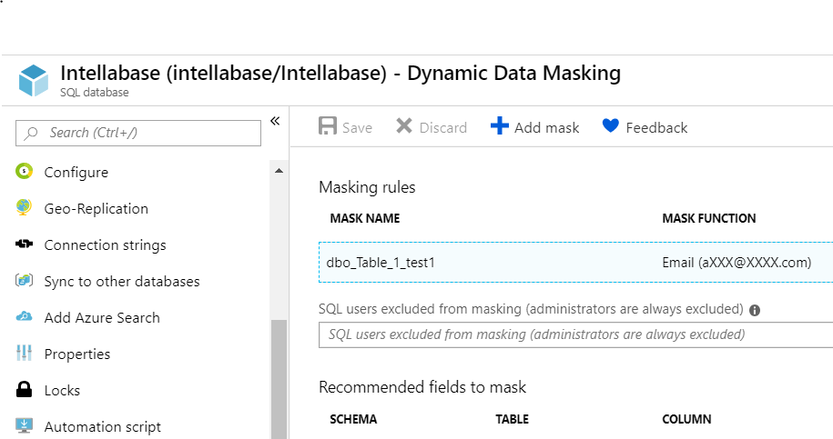
Data Masking – quick SQL Azure demo

Slide 14
Enjoy AzSK! And all the other free tools. For a Deeper dive into controls (Continuous integration, command line tools): https://blogs.msdn.microsoft.com/azuredev/2018/12/29/enforcing-security-controls-right-from-ci-cd-pipeline-with-azsk-deep-dive/ Thank you to C2 for hosting, and Roman Rehak for contributing to VT user group community for over 10 years!
Hugo.Shebbeare@Alithya.com

